Slide 1
Lecture: Computer Vision- Concepts and Techniques

Slide 2
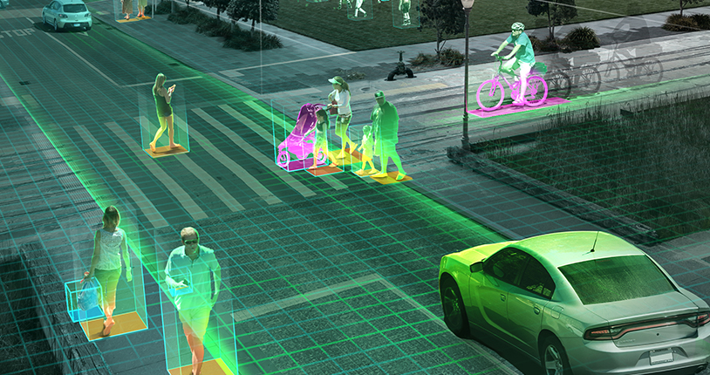
Machines See!
Make computers understand images and videos:
Road: where to drive?
Pedestrians: how many, where, etc?
Cars: how many, how far etc?
Source - https://encyclopedia.mdpi.cn/FgYJ7tjA2_k2FzvlajZoBb_OVmZh

Slide 3
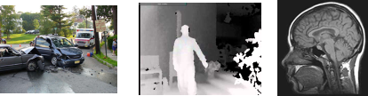
Introduction
Computer Vision (CV) is a field of Artificial Intelligence (AI) that focuses on enabling computers to interpret, understand and analyze digital images and videos in the same way that humans do.
It involves a combination of
image processing techniques,
machine learning algorithms, and
computer graphics
to extract useful information from visual data.
The visual data can take many forms, such as a video sequence, depth images, views from multiple cameras, or multi-dimensional data from a medical scanner.
Source - https://encyclopedia.mdpi.cn/FgYJ7tjA2_k2FzvlajZoBb_OVmZh

Slide 4
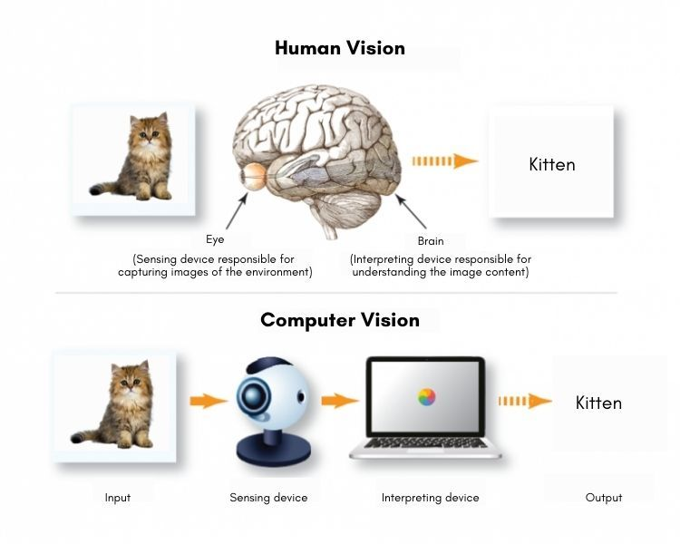
Computer Vision vs Human vision
Source - https://encyclopedia.mdpi.cn/FgYJ7tjA2_k2FzvlajZoBb_OVmZh

Slide 5
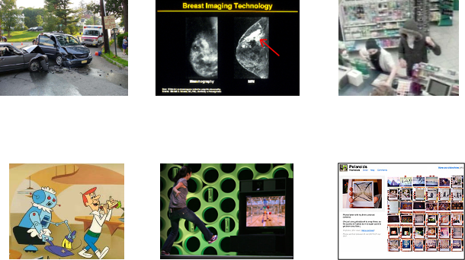
Why CV
Wide range of applications across industries such as healthcare, automotive, entertainment, and security etc.
Source - https://encyclopedia.mdpi.cn/FgYJ7tjA2_k2FzvlajZoBb_OVmZh

Slide 6
Brief History
1960s: Exploring the use of digital images for pattern recognition.
In 1966, Marvin Minsky at MIT (Co-founder AI Laboratory) asked his undergraduate student Gerald Jay Sussman to “spend the summer linking a camera to a computer and getting the computer to describe what it saw”.
1970s and 1980s: Early computer vision systems were developed for applications such as robotics, automated inspection, and medical image analysis.
1990s: Machine learning and the availability of large datasets, CV started to become more sophisticated and accurate.
Recent years: Deep learning techniques such as Convolutional Neural Networks (CNNs), availability of larger datasets and powerful GPUs have revolutionized the field!
Multimodal Models

Slide 7
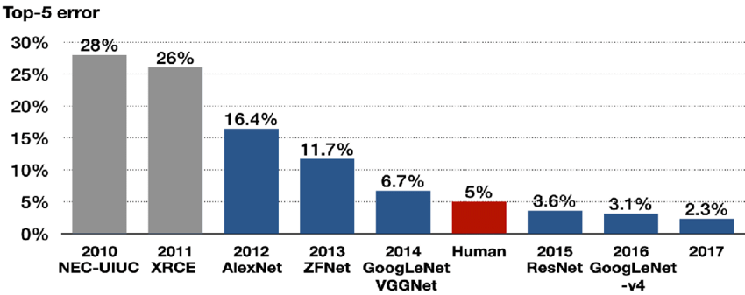
Beat Humans at Image Recognition
ImageNet is an image database with >5000 images per node.
Spans 1000 object classes and contains 1,281,167 training images, 50,000 validation images and 100,000 test images.

Slide 8


Slide 9
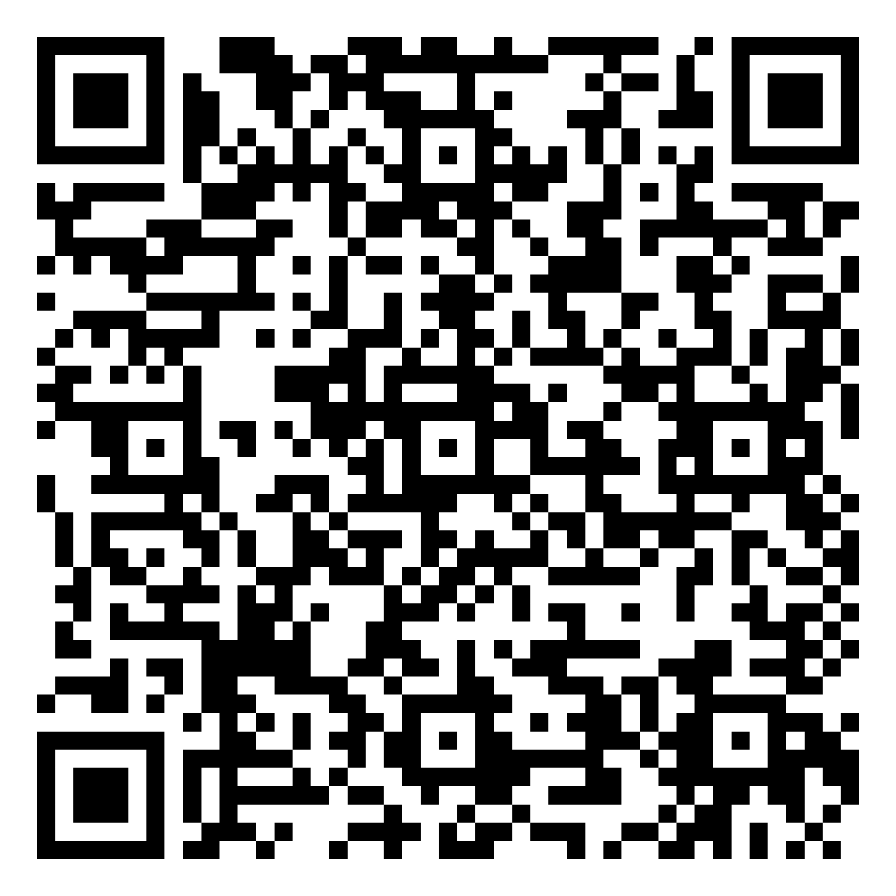
Quiz

Slide 10
Learning Styles Survey
VARK Learning Styles Form: https://forms.gle/K5ZwcQYJMSL58bvcA
Silverman Learning Styles Form: https://forms.gle/cD4GDkzBrPY7N6Ks9
Your participation is greatly appreciated!

Slide 11
How to AI?
How To AI (Almost) Anything
https://mit-mi.github.io/how2ai-course/spring2025/

Slide 12
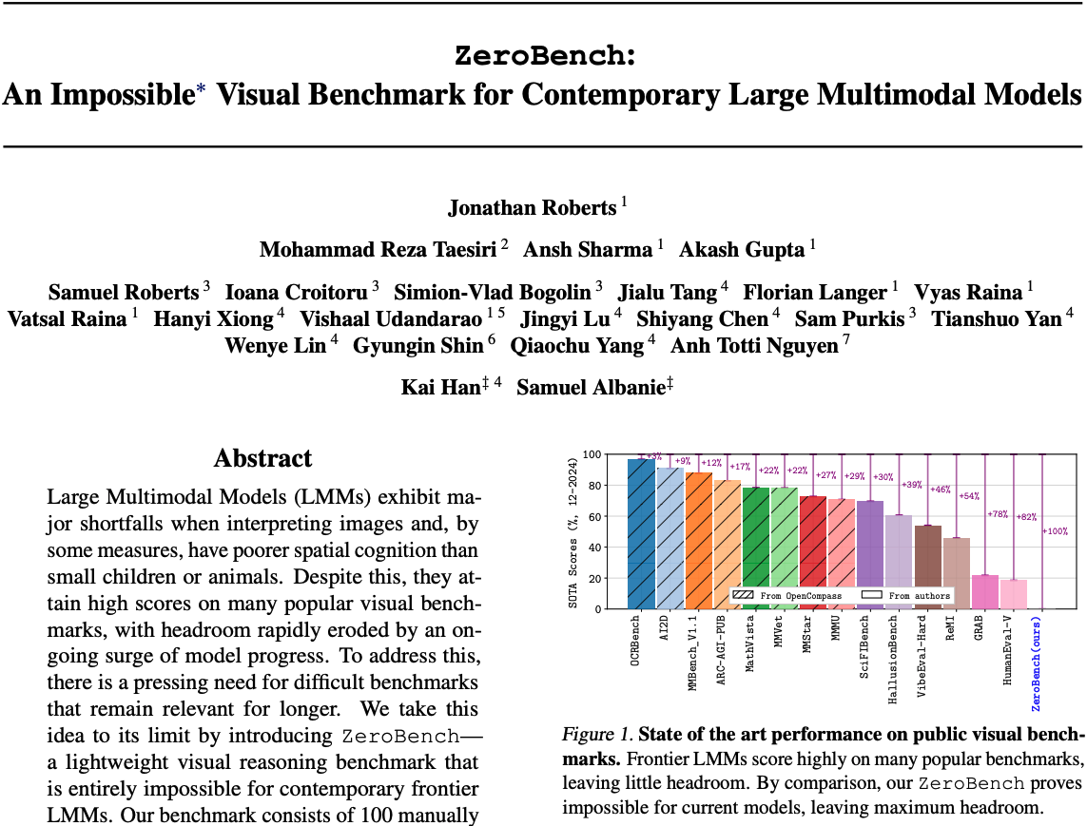

Slide 13
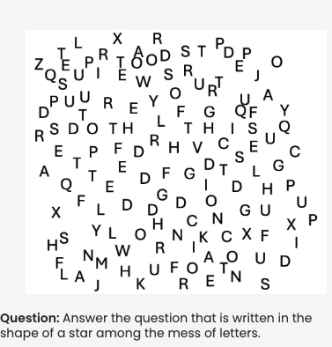
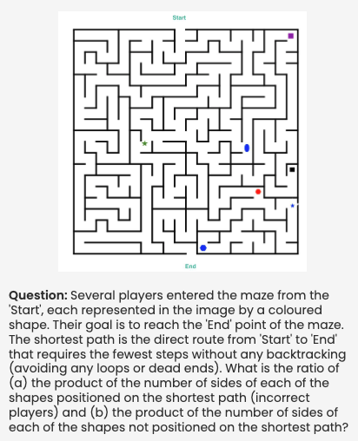

Slide 14
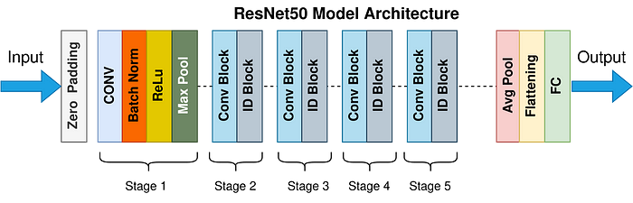
ResNET [2015]

Slide 15
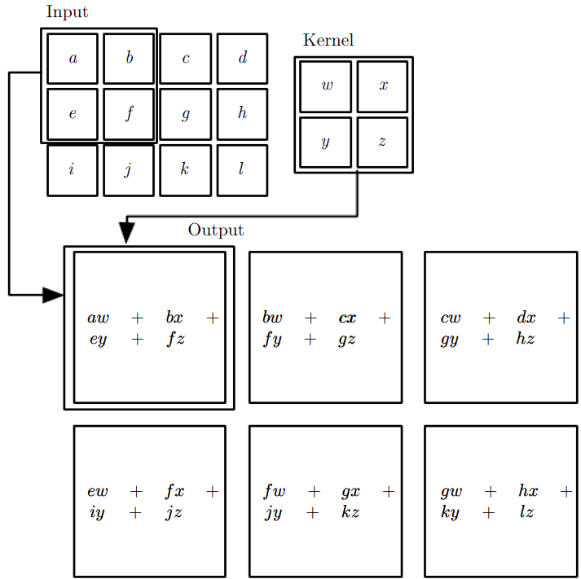
Convolution Operation

Slide 16
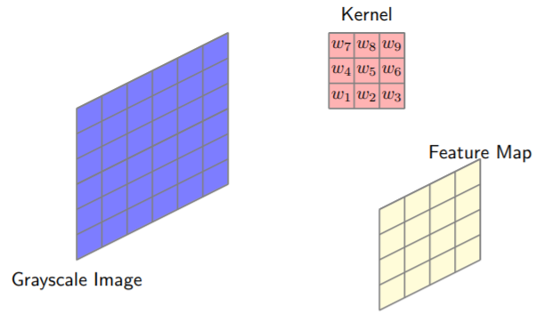
Visual example: Convolution Operation

Slide 17
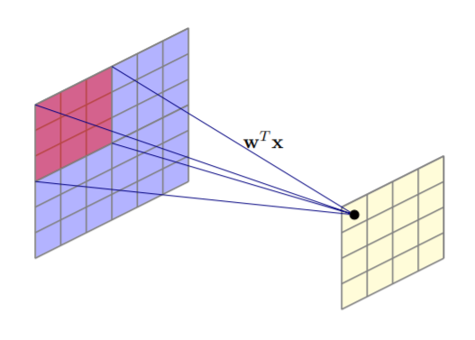
Visual example example: Convolution Operation

Slide 18

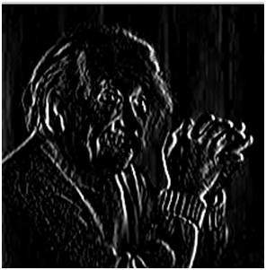
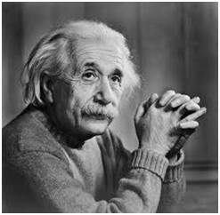
Vertical Edges

Slide 19
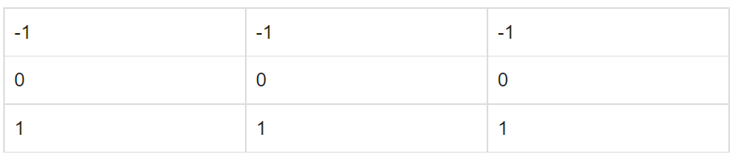
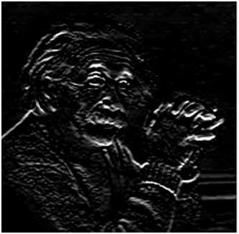
Horizontal Edges

Slide 20
Center Region Values
[[138, 135, 77, 107, 124, 145, 139, 76, 126, 152],
[133, 120, 79, 106, 128, 137, 116, 71, 126, 131],
[128, 87, 84, 104, 145, 132, 88, 88, 125, 107],
[139, 85, 108, 100, 145, 126, 85, 99, 117, 103],
[120, 99, 122, 123, 149, 127, 91, 109, 116, 138],
[108, 97, 129, 134, 148, 115, 87, 131, 135, 150],
[106, 112, 126, 133, 141, 98, 108, 130, 132, 131],
[106, 119, 115, 132, 156, 101, 117, 133, 146, 119],
[ 98, 134, 135, 130, 138, 110, 133, 151, 158, 109],
[107, 129, 153, 159, 129, 109, 127, 148, 149, 91]]

Slide 21
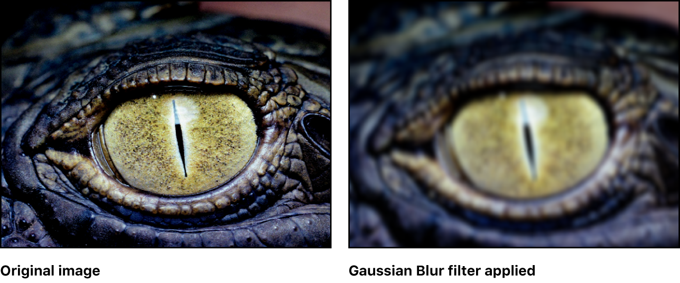
II. Fundamentals of CV: Filterting
Image filtering is the process of enhancing, blurring, sharpening or smoothing an image by applying a filter to it.
Filters can be linear or nonlinear, and can be used for various applications such as noise reduction, edge detection, and feature enhancement.
Example: Gaussian blur filter for reducing noise in an image.

Slide 22
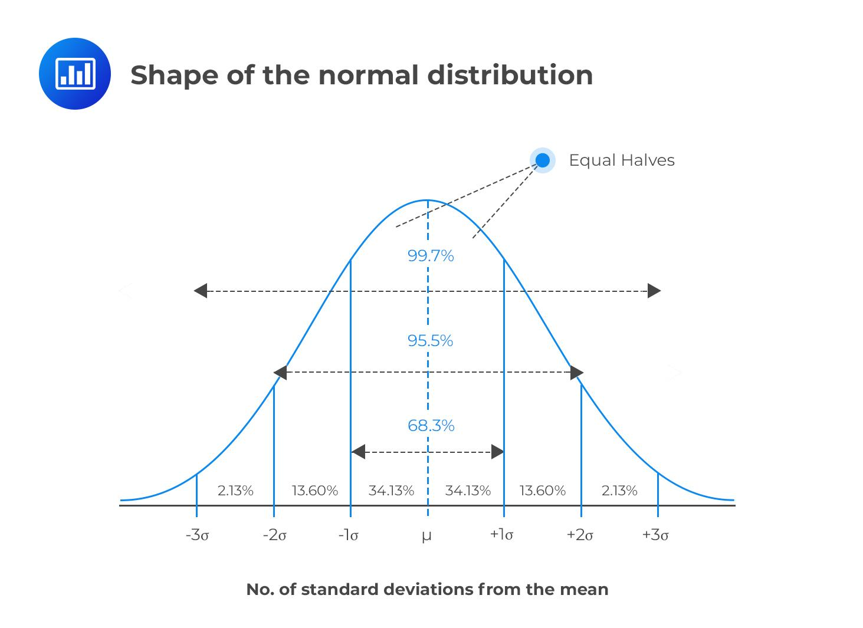
II. Gaussian Kernel
The Gaussian kernel used in image processing is designed to mimic the Gaussian distribution, also known as the normal distribution.
1 2 1
2 4 2
1 2 1
Gaussian kernel is designed to have higher values at the center and lower values towards edges.
Nearby pixels contribute more to the resulting convolution output, with decreasing influence as the distance from the center increases.

Slide 23
Thresholding
function threshold(image, threshold_value):
// Initialize an empty output image
output_image = empty_array
// Loop through each pixel in the input image
for each pixel in image:
// Check if pixel intensity is above threshold
if pixel_intensity(pixel) >= threshold_value:
// Set pixel to maximum intensity (e.g., 255 for 8-bit grayscale)
output_pixel = maximum_intensity
else:
// Set pixel to minimum intensity (e.g., 0 for 8-bit grayscale)
output_pixel = minimum_intensity
// Append output pixel to output image
append output_pixel to output_image
return output_image

Slide 24
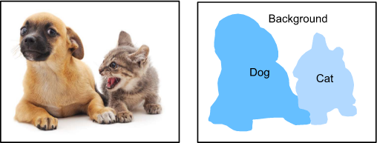
Segmentation
Image segmentation is the process of partitioning an image into multiple segments, each of which represents a different object or region in the image.
It can be done through various techniques such as thresholding, edge detection, and clustering.
Example: Segmenting the foreground object from the background in an image.

Slide 25
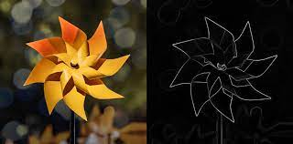
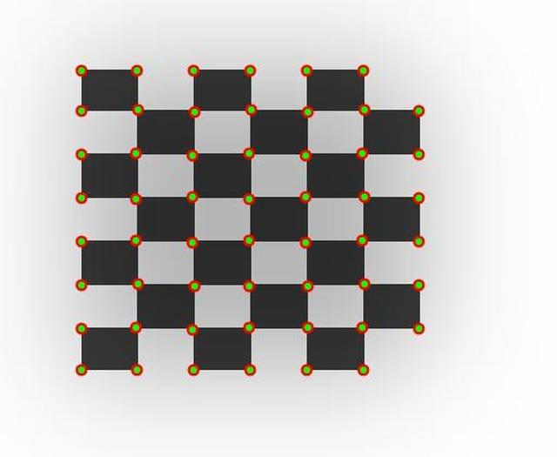
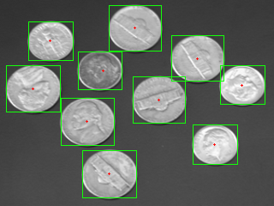
Feature Extraction
Feature extraction involves identifying and extracting specific features or patterns from an image that can be used for further analysis or processing.
Common features include edges, corners, blobs.

Slide 26
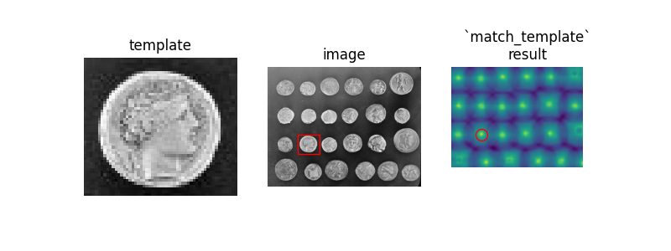
Template Matching
Template matching is a technique used for locating a known object or pattern in an image by comparing it with a template image.
It involves finding the best match between the template and the image by calculating a similarity metric.
Example: Finding a logo or symbol in an image.

Slide 27
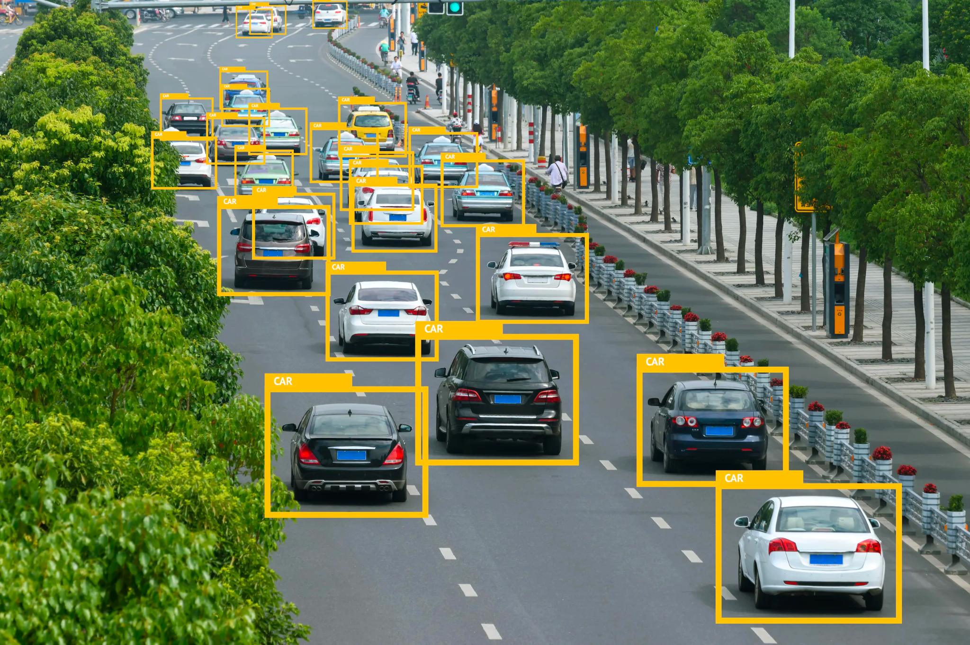
Object detection
Object detection is the process of locating and classifying objects of interest in an image or video.
It involves using machine learning algorithms such as Convolutional Neural Networks (CNNs) to identify objects based on their visual features.
Example: Detecting and classifying different types of vehicles in a traffic scene.

Slide 28
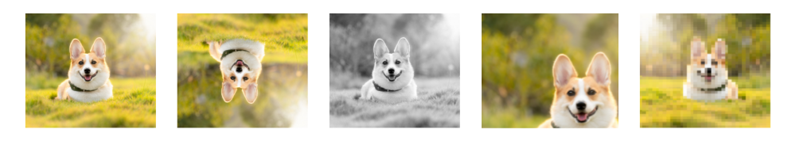
Image Augmentation
Applying a variety of transformations to input images to create new training examples:
Rotation: Rotating the image by a certain angle.
Translation: Shifting the image horizontally or vertically.
Scaling: Resizing the image to a different size.
Flipping: Mirroring the image horizontally or vertically.
Create variations of existing images, making the dataset more diverse.
This diversity can improve the generalization and robustness of machine learning models.

Slide 29
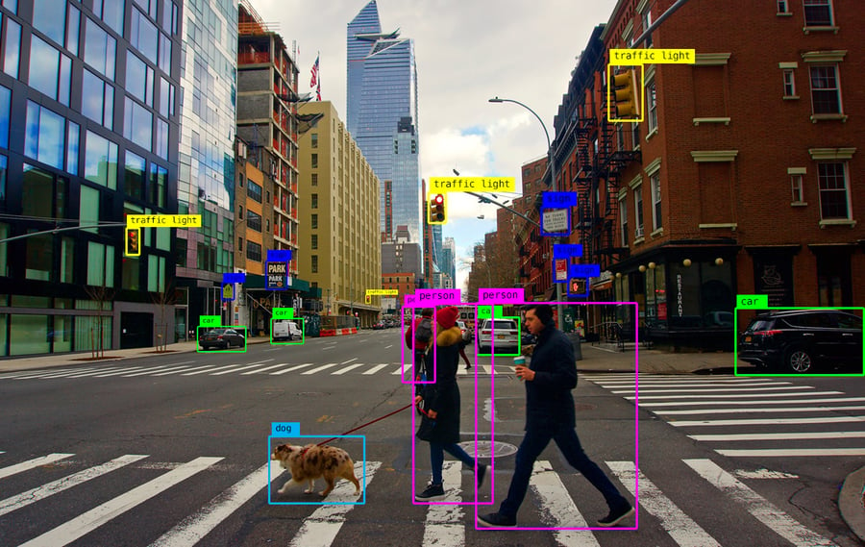
Object tracking
Object tracking involves following a moving object or region of interest in a video over time.
It can be done through various techniques such as feature-based tracking and correlation tracking.
Example: Tracking the movement of a person or vehicle in a surveillance video.

Slide 30
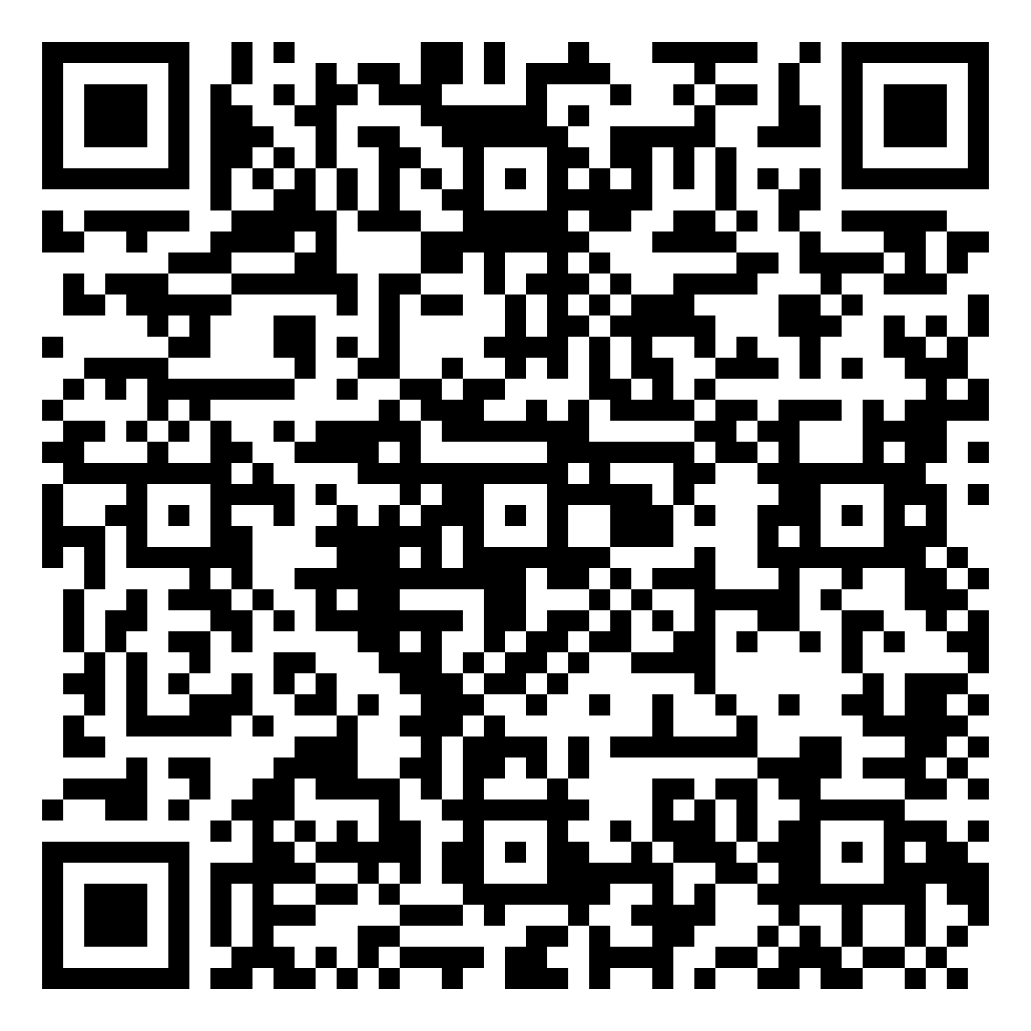
Quiz -2

Slide 31
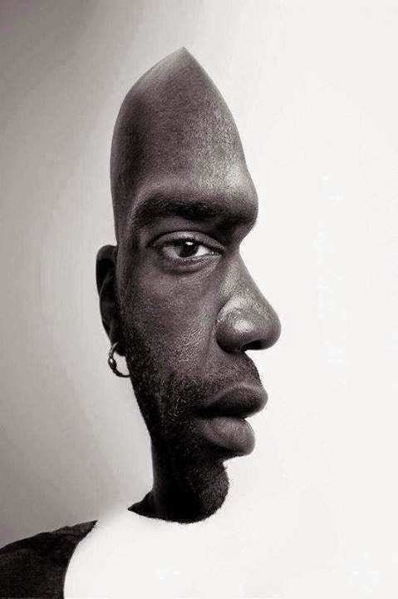
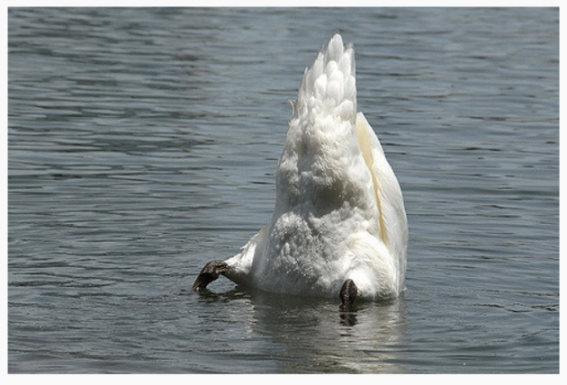
III. Advanced CV Techniques
Some limitations of ML based CV:
DL has revolutionized CV by allowing machines to automatically learn and extract features from images using multi-layer neural networks.
Convolutional Neural Networks (CNN)
Recurrent Neural Networks (RNN)
Generative Adversarial Networks(GAN) etc.
Significantly improved the accuracy and efficiency of various CV tasks such as object detection, recognition, and segmentation.

Slide 32
Frameworks
Caffe: Caffe is a deep learning framework developed by Berkeley AI Research (BAIR).
Fastai: Fastai is a deep learning library built on top of PyTorch.
Detectron2: Detectron2 is a deep learning framework developed by Facebook AI Research (FAIR).
YOLO (You Only Look Once):Real-time object detection system that can detect objects in images and videos with high accuracy and speed.
Tesseract: Open-source OCR (Optical Character Recognition) engine developed by Google.
MediaPipe: Open-source framework developed by Google that provides tools and pipelines for building machine learning and computer vision applications.
Segment-Anything: Pre-trained models for various segmentation tasks, such as instance segmentation, semantic segmentation, and panoptic segmentation.

Slide 33
Suggested Simple Use-cases
Real-time gesture recognition for controlling applications or games.
Face detection and tracking for virtual makeup try-on or face filters.
Hand gesture recognition for controlling smart home devices or presentations.
Pose estimation for analyzing workout routines or yoga poses.
Document scanning and OCR for extracting text from images or documents.
Emotion detection for analyzing facial expressions in videos or video calls.
Body segmentation for virtual try-on of clothes or augmented reality applications.
Real-time image classification for identifying objects or scenes in a live camera feed.
Handwriting recognition for digitizing handwritten notes or documents.

Slide 34
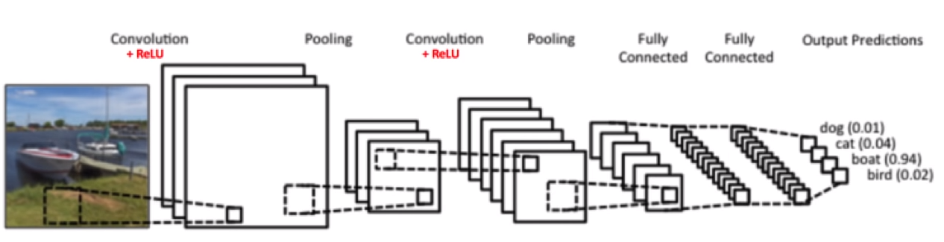
CNNs
CNNs are a type of deep neural network that are commonly used in CV tasks for their ability to extract local features from images and handle variations in object appearance and orientation.
They are composed of convolutional layers, pooling layers, and fully connected layers.

Slide 35
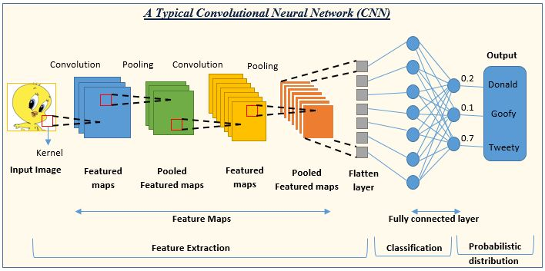
CNNs

Slide 36
Convolution Operation: Output Size
For convolutional layer:
Suppose input is of size W₁ × H₁ × D₁
Filter size is K and stride S
We obtain another volume of dimensions W₂ × H₂ × D₂
W₂ = (W₁ − K)/S + 1 and H₂ = (H₁ − K)/S + 1
Depths will be equal

Slide 37
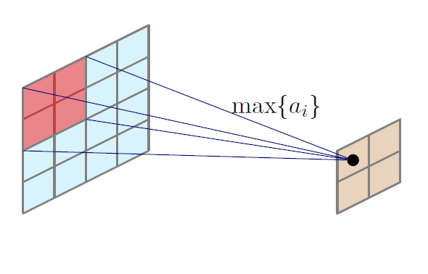
Pooling: Max Pooling

Slide 38
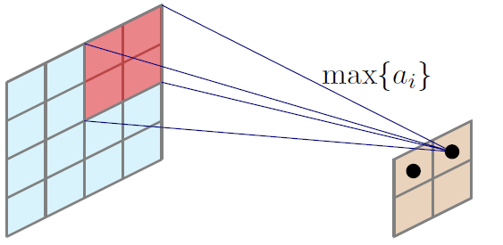
Pooling: Max Pooling

Slide 39
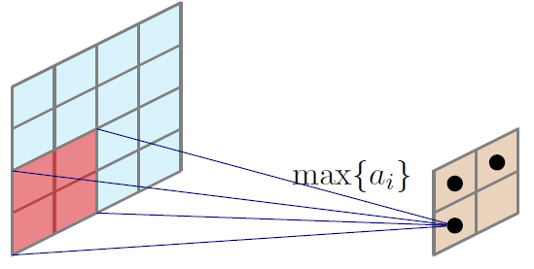
Pooling: Max Pooling

Slide 40
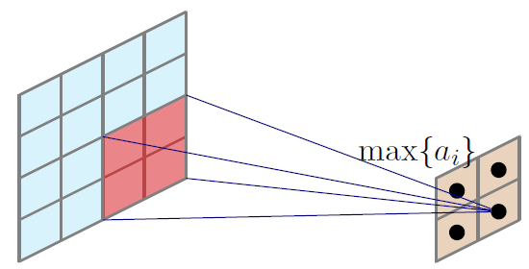
Pooling: Max Pooling

Slide 41
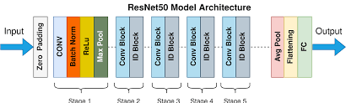
ResNET
ResNet-50 is a CNN architecture that was introduced in 2015.
It consists of 50 layers and has > 23 million trainable parameters.
The ResNet-50 model has been trained on large datasets such as ImageNet, which consists of over 1.2 million images
Input Size: 224x224
Total number of computations for a single pass = 263.4 million.
The training time for the ResNet-50 model takes around 1 to 2 days on a single RTX 3080 GPU.

Slide 42
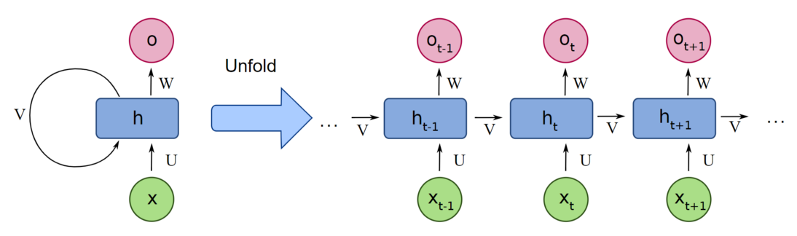
RNNs
RNNs can model sequential data by processing input data in a sequence, where the output of each step is fed back as input for the next step.
Commonly used for time-series analysis.
RNNs have a "memory" that allows them to retain information about the previous inputs.
Composed of multiple recurrent layers.

Slide 43
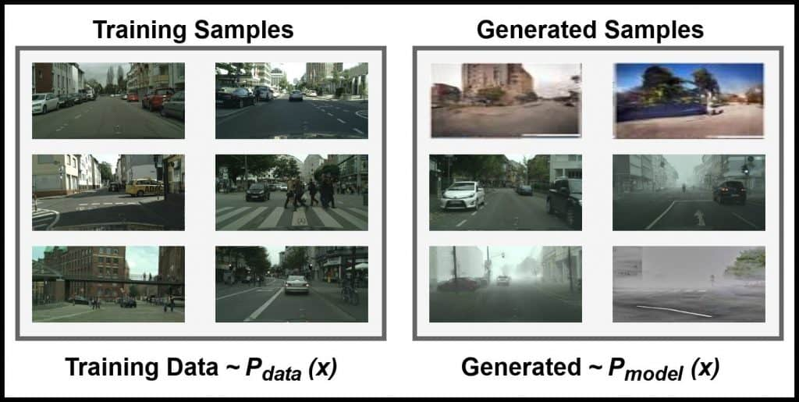
Generative Models
Generative models are a class of DL models that can generate new data samples that are similar to the training data.
They are useful for various CV tasks such as image generation, style transfer, and data augmentation.

Slide 44
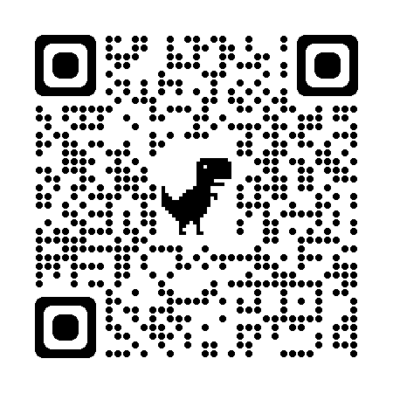
Quiz-3

